Slide 1

Microsoft Studio Analysis
Nicholus Magak
November 10, 2020

Slide 2

Problem Statement
Microsoft wants to create original video content, just as other big companies. Their way forward was to create a new movie studio, but they don't know how to make movies.
Unfortunately, if they can not make the studio to appeal to an audience, then Microsoft may lose a potential area to gain customers and overall regular customers due to its inability to adapt to new media.

Slide 3
Solution
Finding the films that are doing the best in the box office, using EDA, then relaying the findings in the potential actions the head of the new studio can use to decide what type of films to create is the main goal.

Slide 4

MVP
The topics to explore:
Most profitable movies
Most popular genres
Actor to likeability ratio

Slide 5
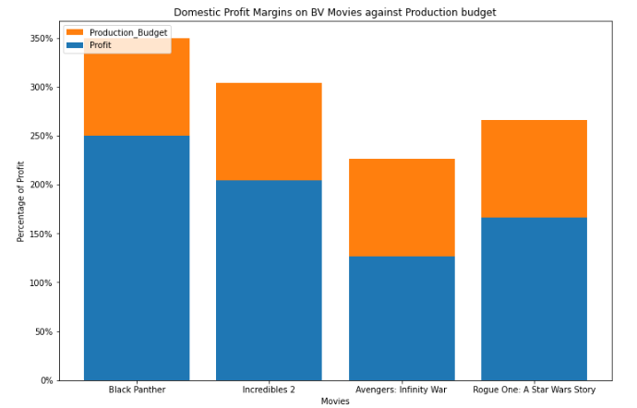
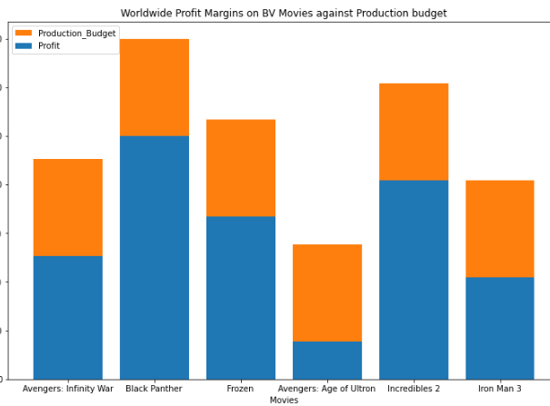
Development Process
Q1: Which movies were the most profitable?

Slide 6
Solution (Q1)
When both most successful movies from BV in foreign and domestic regions were placed together, I found the average of the budget and, if Microsoft is to make a big impact on the market, then their production budget should be around $175,000,000

Slide 7
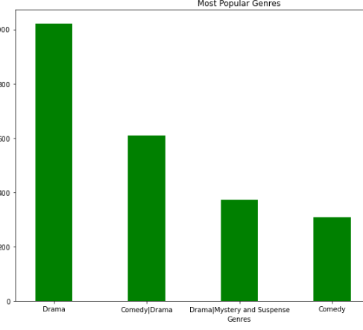
Development Process
Q2: Most popular genre?

Slide 8

Solution (Q2)
The way forward is to focus on the Drama genre in order to reach the most views possible because they are the most rated per view.

Slide 9
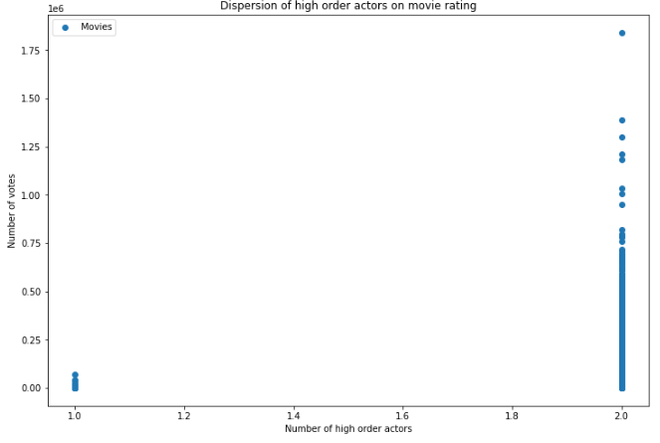
Development Process
Q3: Do higher order actors affect move likeability?
it is visible that the movies that had more high order characters in them had more votes and therefore, more views. The thought process is that when there are more familiar characters in a movie, then, the audience is more likely to watch them

Slide 10
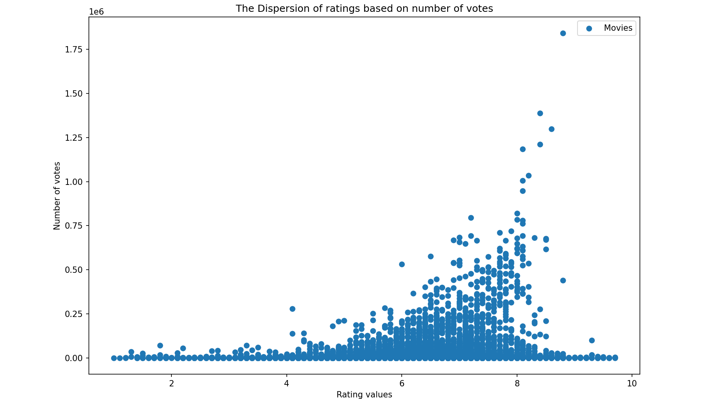
Solution (Q3)
On top of that, I also wanted to find out if more reviews in a movies would likely mean that it is good, and viewers recommend movies they like to each other. This can be seen from the plot below which show how the more likeable movie had the greatest number of reviews and votes.

Slide 11
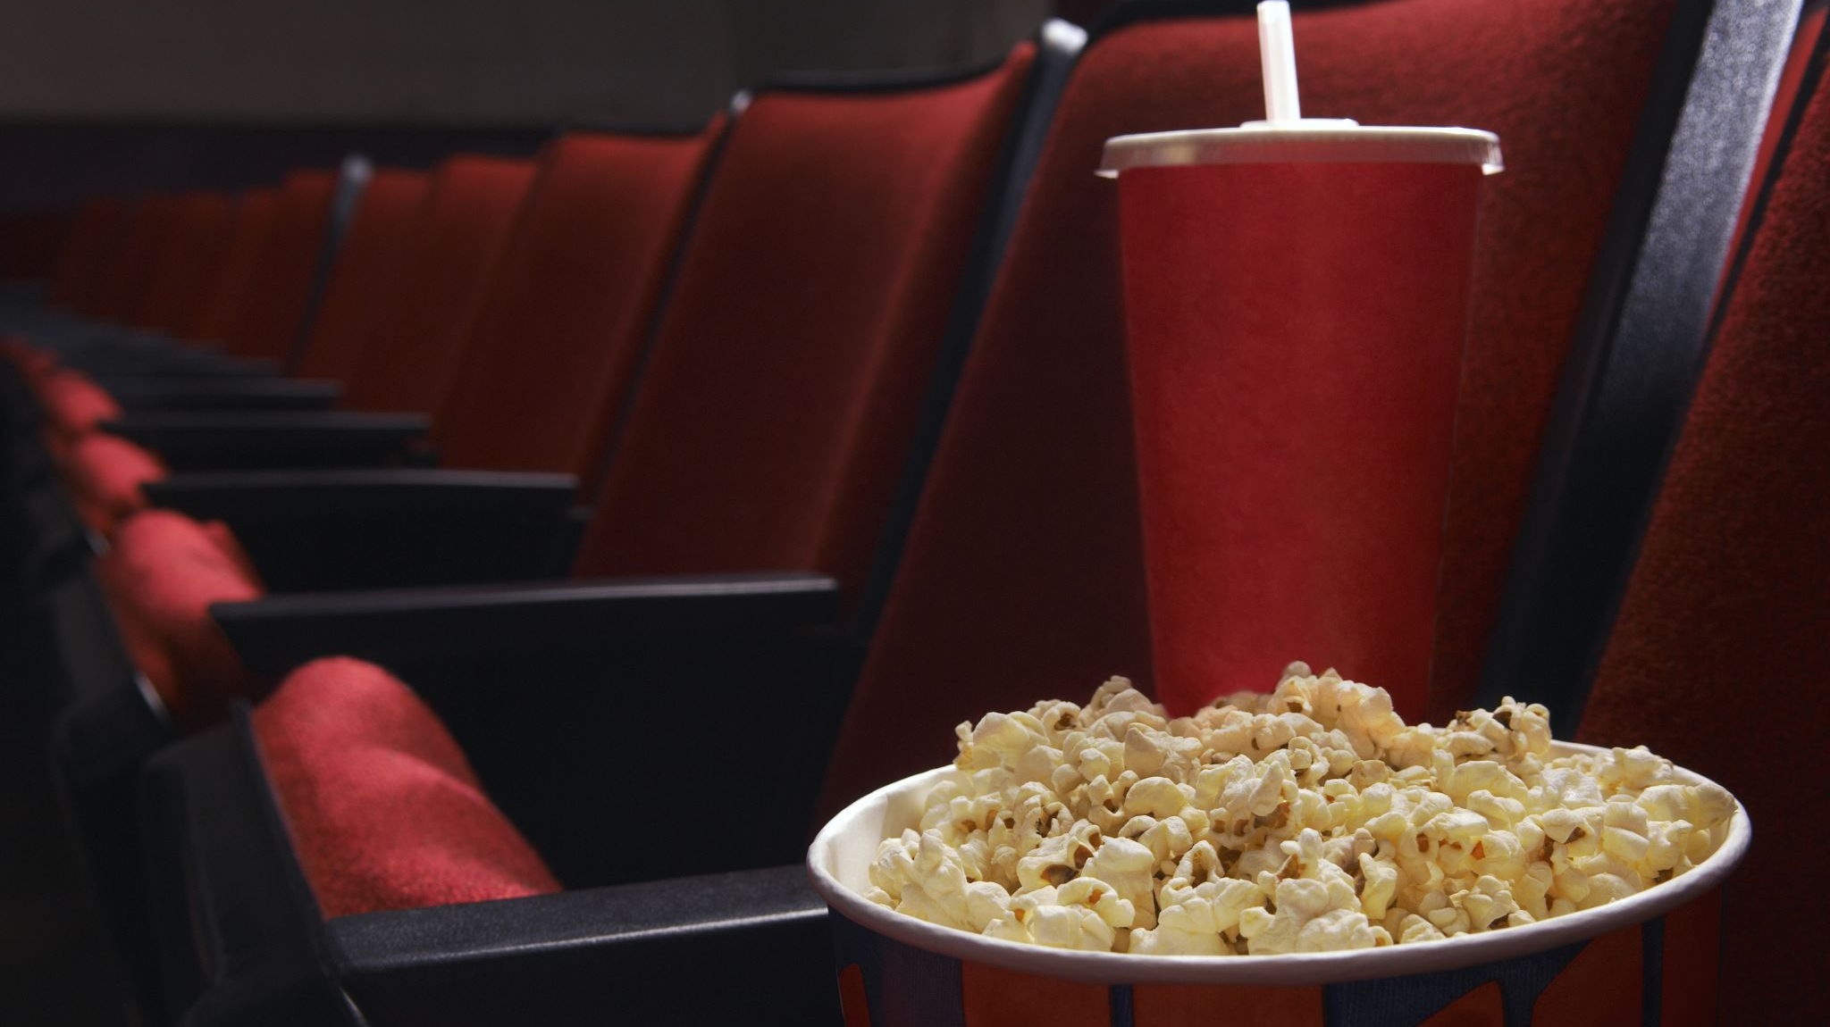
Solution (Q3)
The view would be that Microsoft Studios should investigate getting more familiar characters in a movie. This will end up exciting its audience causing the movie to get more views and overall ratings.

Slide 12
Thank You!

